Slide 1
Social Network Analysis in Public Health
Rany Octaria, MD, MPH
Healthcare-Associated Infections and Antimicrobial Resistance Program
Tennessee Department of Health
Vanderbilt University Epidemiology PhD Program

Slide 2
What is Social Network Analysis (SNA)
A growing field with increasing number of articles published in 21st century (Borgatti et al. 2009)
Another way to collect, visualize, and analyze data
Everything is interconnected
The way of learning and thinking of a world that focuses on relationships

Slide 3

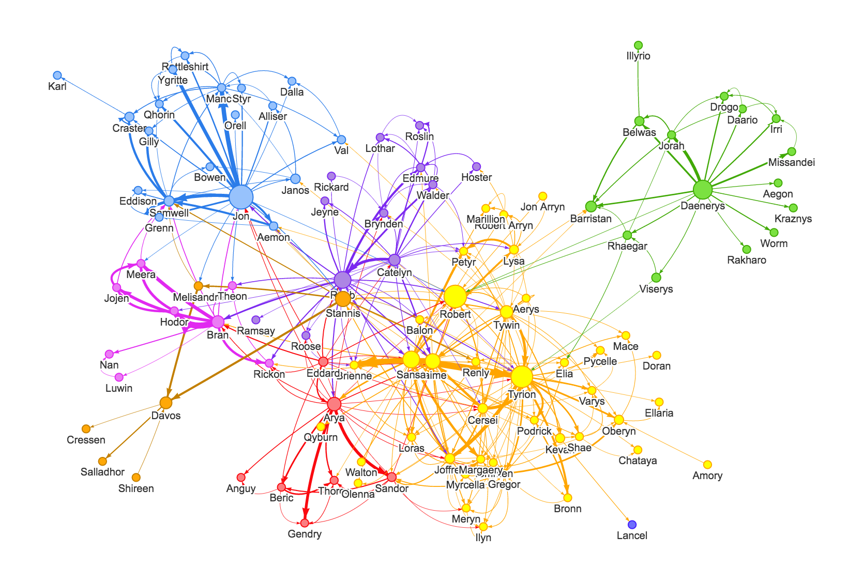
Social Network Analysis
GoT Social Network
In social sciences
Game of Thrones social map (Early Seasons)

Slide 4
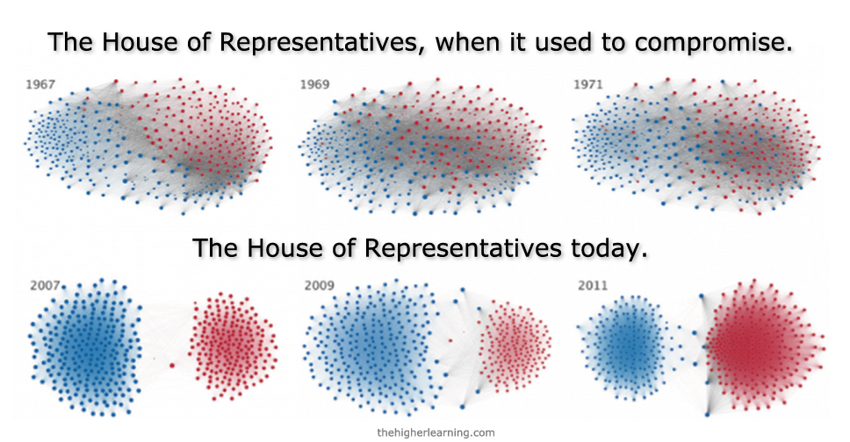
Social Network Analysis
House of Representative, 1967-1971
Voting Pattern in the U.S. House of Representative

Slide 5
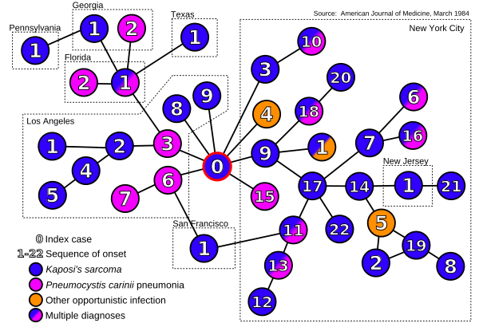
Social Network Analysis
In Public Health
HIV index case in the US

Slide 6
What is a network?

Slide 7
What is a network?
Nodes
Nodes

Slide 8


What is a network?
Nodes
People
Nodes
People

Slide 9

What is a network?
Nodes
Organization
Nodes
Organization

Slide 10
What is a network?
Nodes
People
Organization
Both
Nodes
People
Organization

Slide 11
What is a network?
Nodes
People
Organization
Both
Ties

Slide 12
What is a network?
Nodes
People
Organization
Both
Ties
Relationships between nodes

Slide 13
What is a network?
Nodes
People
Organization
Both
Ties
Relationships between nodes
Often called edges
Ties = edges

Slide 14

What is a network?
Nodes
People
Organization
Both
Ties
Relationships between nodes
Often called edges
Ties = edges
Personal

Slide 15


What is a network?
Nodes
People
Organization
Both
Ties
Relationships between nodes
Often called edges
Ties = edges
Personal
Communication

Slide 16
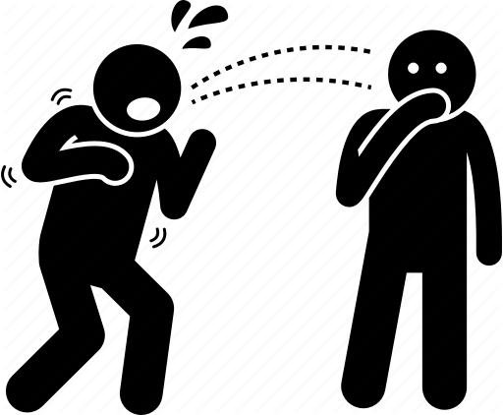
What is a network?
Nodes
People
Organization
Both
Ties
Relationships between nodes
Often called edges
Ties = edges
Personal
Communication
Disease Transmission

Slide 17

What is a network?
Nodes
People
Organization
Both
Ties
Relationships between nodes
Often called edges
Ties = edges
Personal
Communication
Disease Transmission
Joint Activities

Slide 18

Ties in a network
Because of the nature of relationships
between people and organization
Ties can be unidirectional

Slide 19
Ties in a network
Because of the nature of relationships
between people and organization
Ties can be directional

Slide 20

Ties in a network
Because of the nature of relationships
between people and organization
Ties can be
one-sided

Slide 21
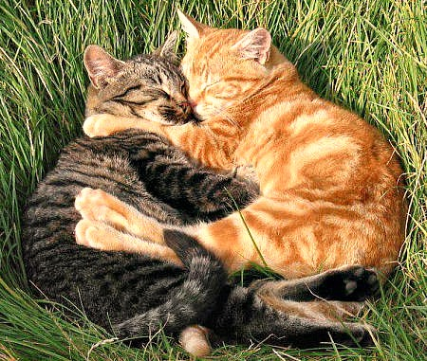
Ties in a network
Because of the nature of relationships
between people and organization
Ties can be
reciprocal

Slide 22
Questions that can be answered by SNA
Which behaviors are most associated with a current HIV outbreak?
What is the structure of communication chains in TN emergency response?
What characteristics are associated with highly connected individuals?

Slide 23
Use of Network Analysis in Public Health
Visualize disease transmission and its hotspots
Improve coordination between public health entities to enhance response
Improve spread of messages with targeted intervention

Slide 24
Data Collection and Management

Slide 25
Data Sources
Pre-existing dataset
Social Media, hospital discharge data, etc
Collect your own data
Surveys and interviews
Combine both

Slide 26
Data Collection Strategies
Identify the entire network before starting
e.g. organizational studies, defined network
Snowball or Respondent-Driven
Subjects nominates other people
e.g. transmission of infectious diseases

Slide 27
Collecting Network Data
Who is in the network? (NODES)
What are their characteristics?
Patients : Age, Sex, Behaviors related to the study, Ethnicities
Organizations: Size, Type, Number of beds or employees, revenue, etc
How are they connected to each other?
There can be more than 1 type of ties

Slide 28
Application 1
Mumps Outbreaks
Where?
Shelby County School District, Memphis, TN
Who?
Teachers, faculty, students and households
Problem:
Are there major clusters?
Who should receive targeted public health interventions ?
Who are the key patients with high likeliood of spreading the disease?
Notes:
Large social network with many exposures and interconnections. We needed a way to visualize the relationships between cases within the clusters. Had the outbreak continued to grow, this would have helped us decide on potential targeted public health interventions; including expanded messaging and whether or not to offer a third MMR dose per CDC guidelines.

Slide 29
Managing Social Network Data

Slide 30
Edges : Epi-contact data
Person1 | Person2 | Relationship_code | Relationship_type
person101 | person102 | 1 | Household contact
person102 | person103 | 1 | Household contact
person101 | person103 | 1 | Household contact
person101 | person201 | 2 | School contact

Slide 31
Nodes : Attribute Data
id | age_years | sex | household_id | homeless | vaccinated | country_origin
person101 | 65 | M | 1 | yes | yes | USA
person102 | 23 | F | 1 | no | no | USA
person103 | 6 | M | 1 | yes | yes | USA
person201 | 8 | F | 2 | no | no | Indonesia
Inputs on characteristics to include are welcomed!

Slide 32
Analyzing Social Network

Slide 33
Broad Approach
Visualization
Allows viewers to view graphical depiction of the network
Descriptive Analyses
Position of network actors
Characteristics of the network as a whole
Model
Build and test network models and make inferences
Properties of subgroups

Slide 34
Visualization
What is the overall structure of the network?
Does the network structure tells you anything?
Romantic and sexual relationships among 288 students at “Jefferson High School.” From http://www.sociology.columbia.edu/pdf-files/bearmanarticle.pdf

Slide 35
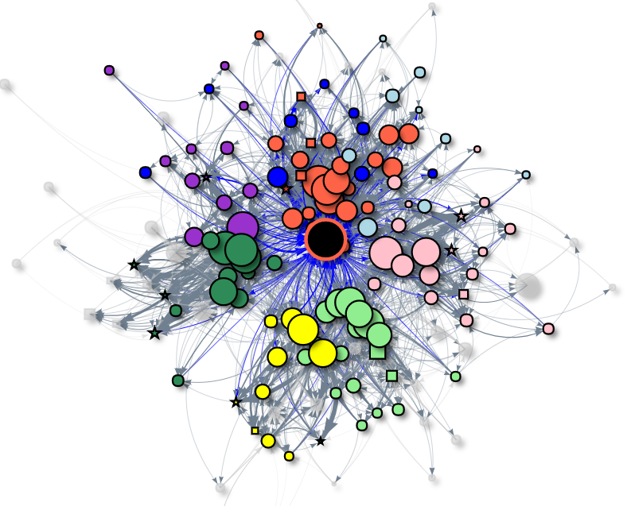
Visualization
What is the overall structure of the network?
Does the network structure tells you anything?
What about this?
Patient sharing network between 154 hospitals in Tennessee in 2017, colored by region

Slide 36
What Statistics do we analyze?
Network –level
statistics
Node-level statitsics

Slide 37
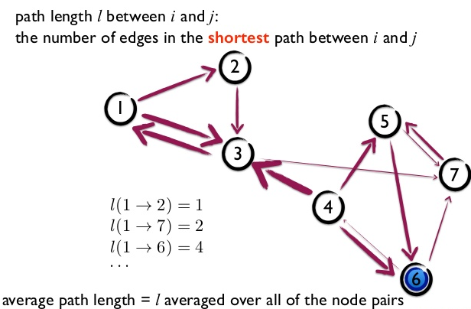
Network level statistics
Density
Out of all possible connection, what proportions actually exist?
Average path
In average, how many “steps” are needed through the shortest paths to connect all possible pairs of nodes

Slide 38
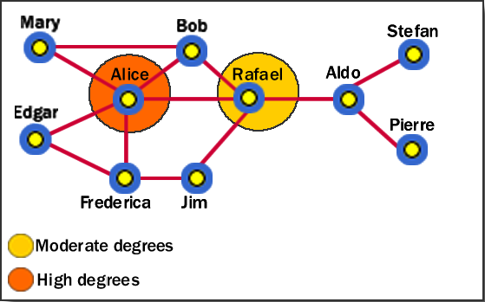
Node-level statistics
Degree Centrality
The number of direct relationships of a node
High centrality
generally an active
often a connector or hub in the network
Is not necessarily the most connected entity in the network
advantaged position in the network.
http://www.fmsasg.com/SocialNetworkAnalysis/

Slide 39
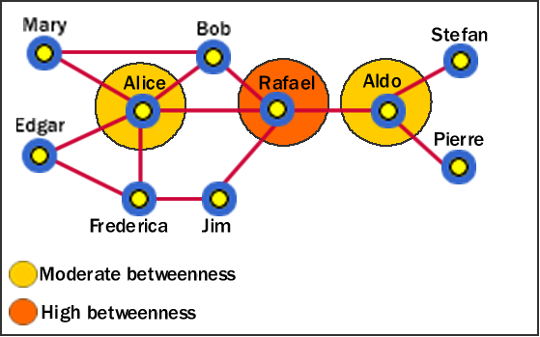
Node-level statistics
Betweenness
How many times the node serves as the connector between two other nodes
High betweenness
Holds a favored or powerful position in the network.
Can easily disconnect connection between cliques
Has a greater amount of influence over what happens in a network.
http://www.fmsasg.com/SocialNetworkAnalysis/

Slide 40
Resources for Network Analysis
SNA Softwares : Pajek, UCINET
Programming Software
R Studio packages: igraph, STATNET
Learning Resources
Datacamp Social Network Analysis
NACCHO Toolbox : http://toolbox.naccho.org/pages/tool-view.html?id=5731
Shiny App

Slide 41
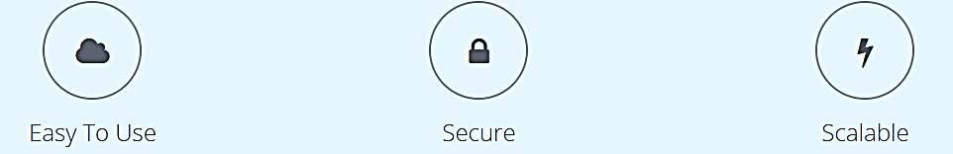
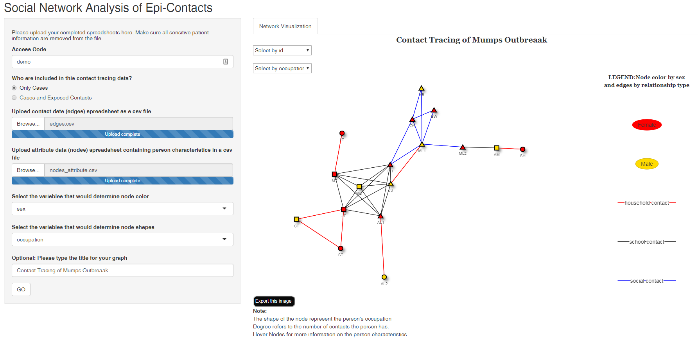
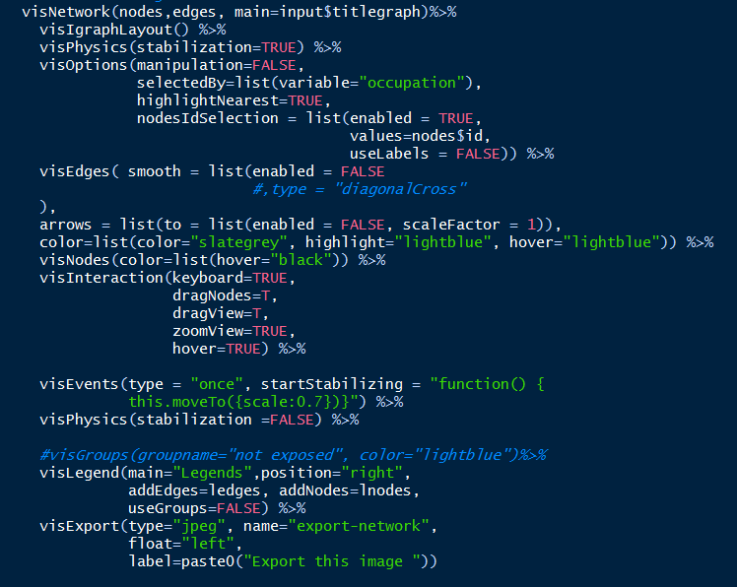
Shiny in R
Transforming Codes into Interactive Web Applications

Slide 42
Visualizing your outbreak data
Collect Your Data
Upload your Data
Customize the visualization
Choose data collection platform
Determine person characteristics
Collect Data
Format it to be Shiny-compliant
Strip Patient Identifiers
Request Access Code
www.tnsocialnetwork.shinyappps.io/shiny
Features to be developed based on your feedback
Customize what characteristics determine
Color
Shape
Of the nodes and lines

Slide 43
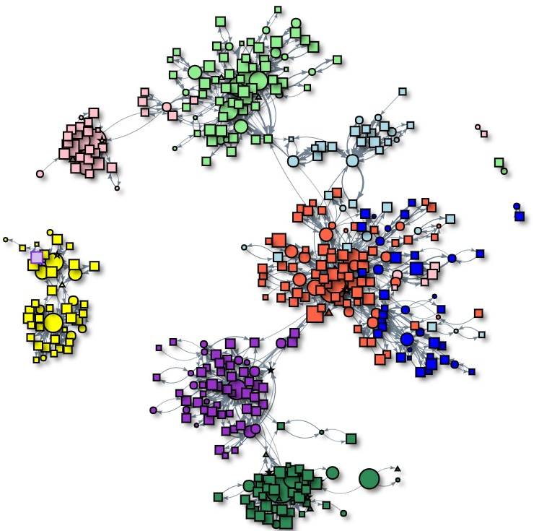
Contact
www.tnsocialnetwork.shinyappps.io/shiny
Rany Octaria
Rany.Octaria@tn.gov

